Slide 1












Slide 2


AtliQ Hardwares
SQL Resume Project
CONSUMER GOODS AD-HOC INSIGHTS
PRESENTED BY:
Ujjwal Garg

Slide 3
Agenda
01 | Overview/Context
02 | Company Global Market
03 | Company product line
04 | Data Familiarization
05 | Ad-Hoc-Analysis

Slide 4
Company Overview
Atliq Hardwares (imaginary company) is one of the leading computer hardware producers in India and well expanded in other countries too.
Project Objective
The management noticed that they do not get enough insights to make quick and smart data-informed decisions.
To address this, they have decided to expand their data analytics team by hiring several junior data analysts.
Overview / Context
Task Overview
The goal is to provide the management with deeper insights into their operations through data analysis.
Address 10 ad hoc business requests using SQL queries.
Derive insights from the ad hoc requests.

Slide 5
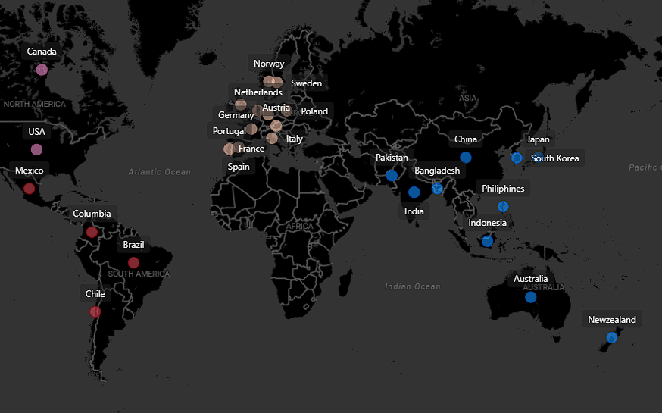
Company Global Market
Region
NA
LATAM
EU
APAC

Slide 6
Company Product Line
Division
PC
P & A
N & S
Segment
Desktop
Notebook
Peripherals
Accessories
Networking
Storage
Business Laptop
Personal Laptop
Gaming laptop
Business laptop
Personal laptop
Graphic card
Internal HDD
MotherBoard
Processors
Batteries
Keyboard
Mouse
Wi Fi Extender
External SSD
USB Flash drives
Category

Slide 7
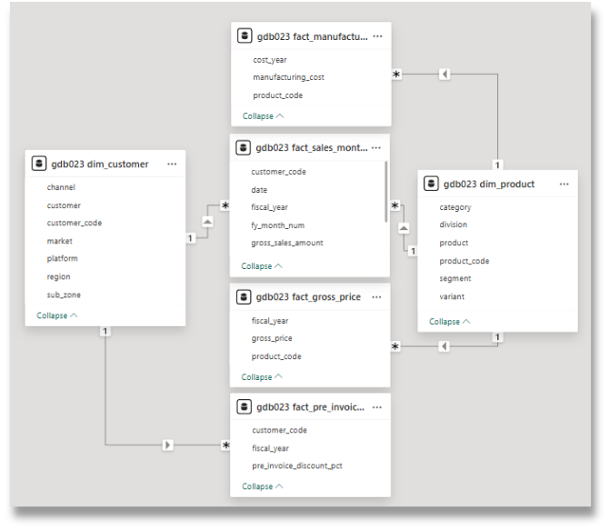


Data Familiarization
Fact Tables and Dimension table of the input data.
Input data consists of sales data for FY 2020 and FY 2021
Tool Used
PowerBI & MySQL

Slide 8




Ad-Hoc-Analysis
Output/Visual
Insights
Ad-Hoc-Request
Query Performed

Slide 9
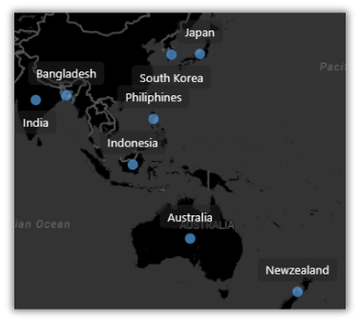
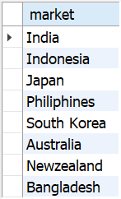
Request #1
Provide the list of markets in which customer "Atliq Exclusive" operates its business in the APAC region.
Output/Visual

Slide 10
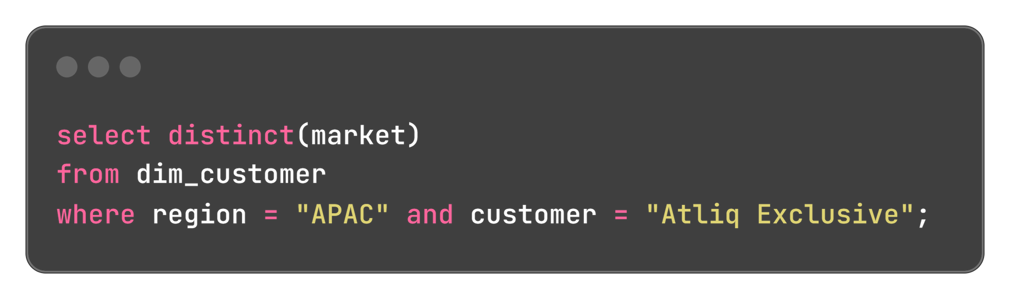
Query

Slide 11
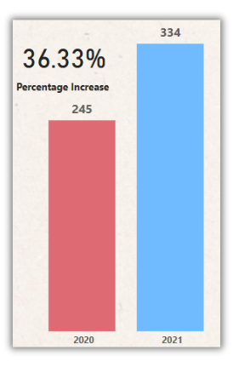
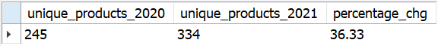
Request #2
What is the percentage of unique product increase in 2021 vs. 2020?
Output/Visual

Slide 12
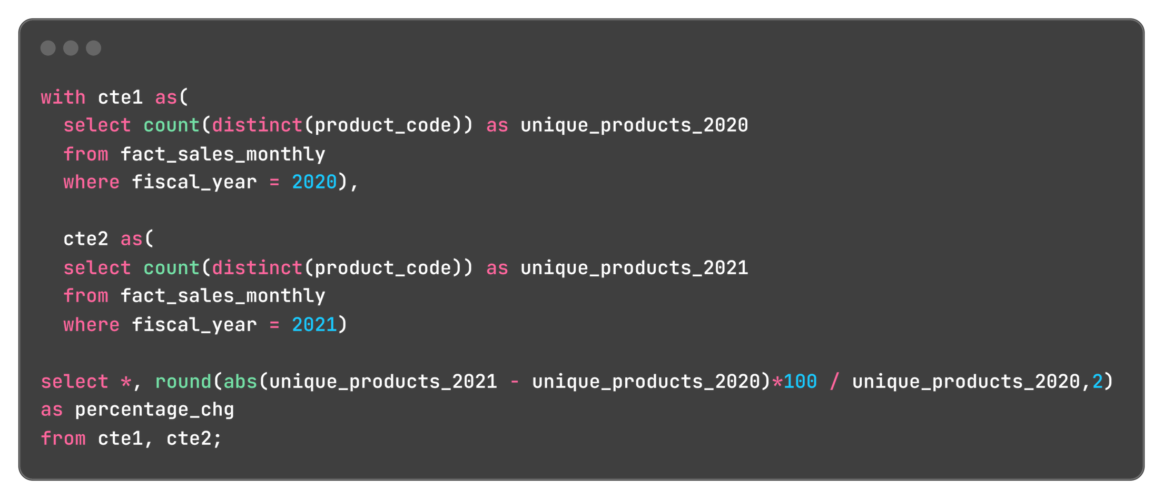
Query
Insight
With a 36.33% increase in new products, AtliQ Hardware is dynamically meeting evolving customer needs, leading to significant demand and production growth.

Slide 13
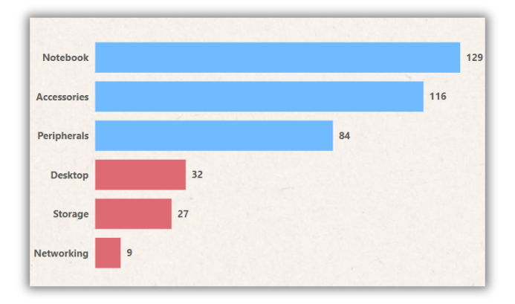
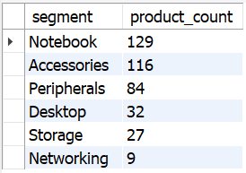
Request #3
Provide a report with all the unique product counts for each segment and sort them in descending order of product counts.
Output/Visual

Slide 14
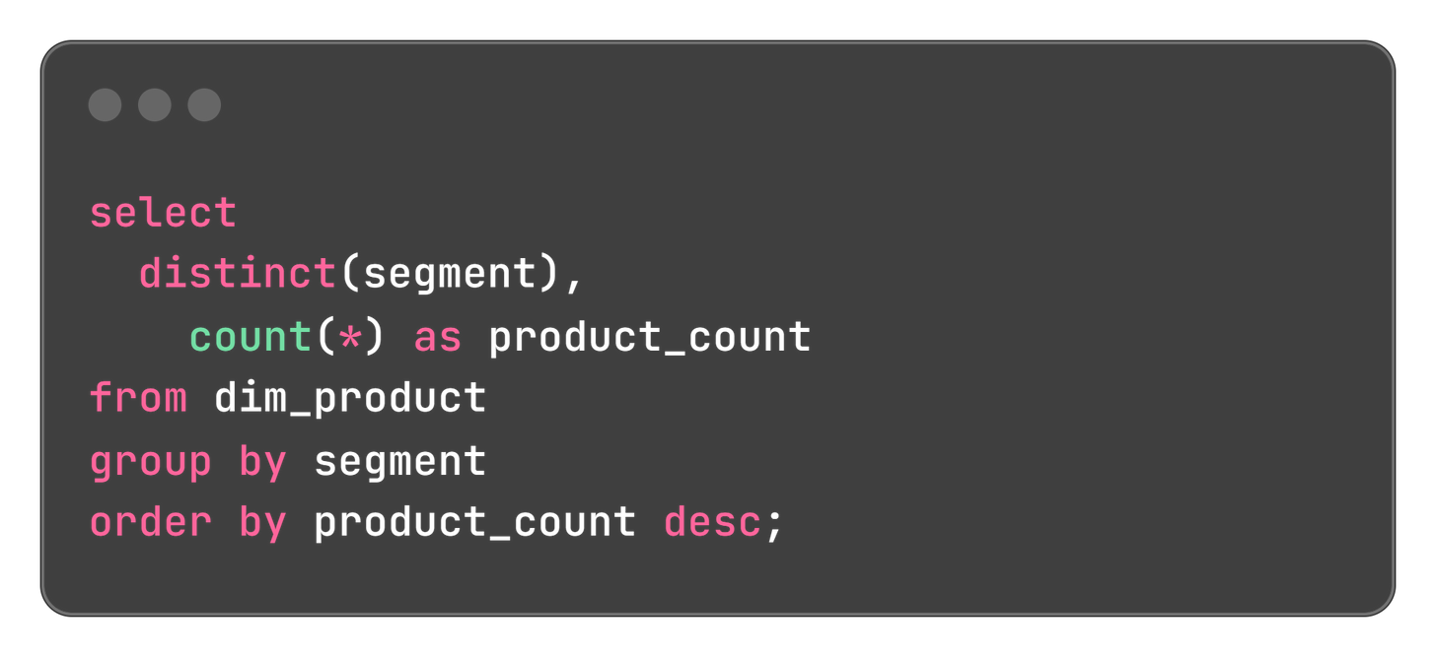
Query
Insight
Notebooks, accessories, and peripherals, constituting 83% of total manufacturing compared to desktops, storage, and networking.
To diversify, we need to expand production in the latter segments.

Slide 15
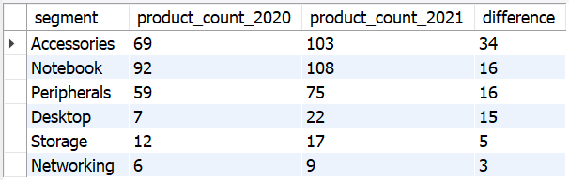
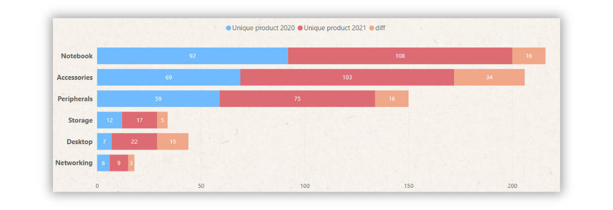
Request #4
Which segment had the most increase in unique products in 2021 vs 2020?
Output/Visual

Slide 16
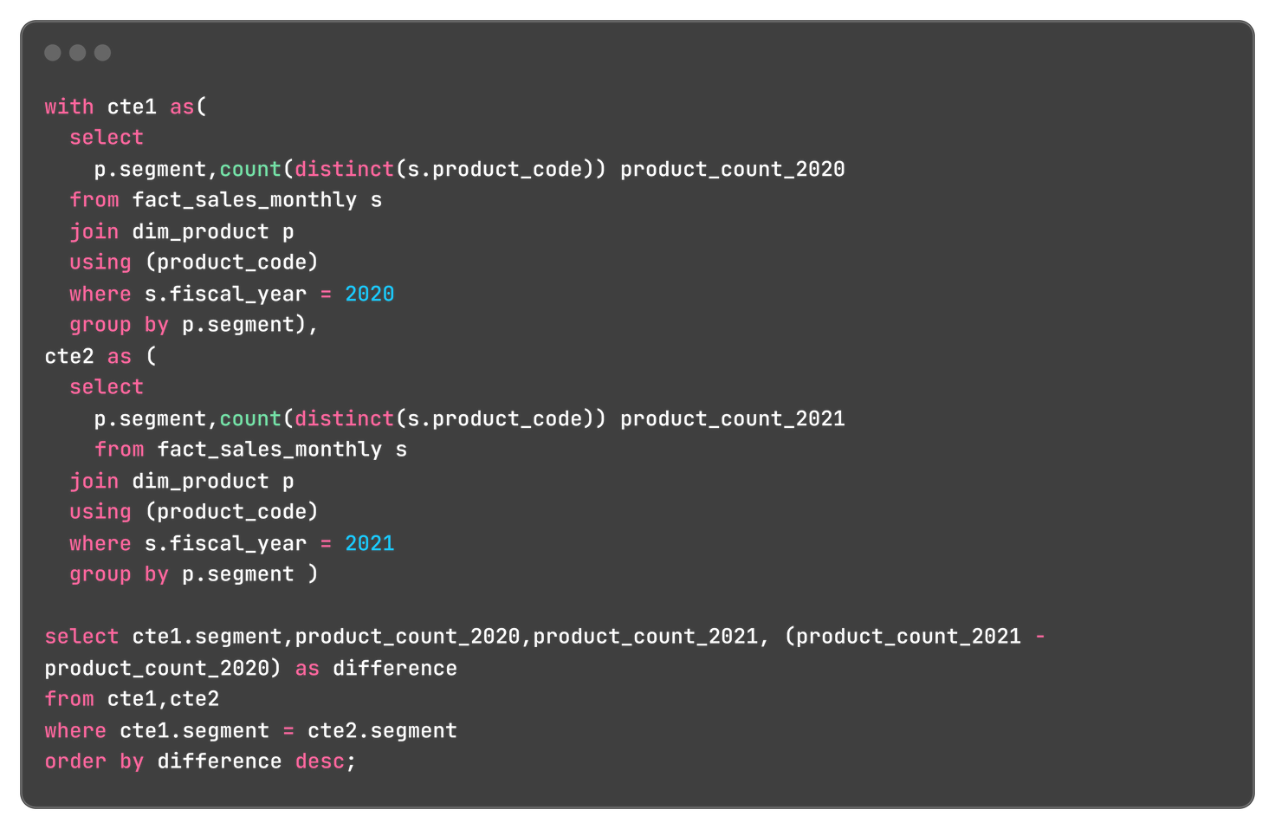
Query
Insight
Accessories saw the largest growth with 34 new products, while notebooks and peripherals added 16 each. Despite the desktop segment's notable rise from 7 to 22 products, networking and Storage lags with only 3 and 5 new additions respectively since 2020, highlighting the need for focus on storage and networking.

Slide 17
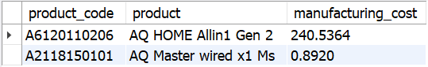
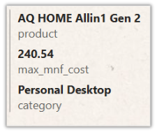
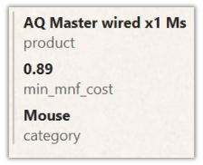
Request #5
Get the products that have the highest and lowest manufacturing costs.
Output/Visual

Slide 18
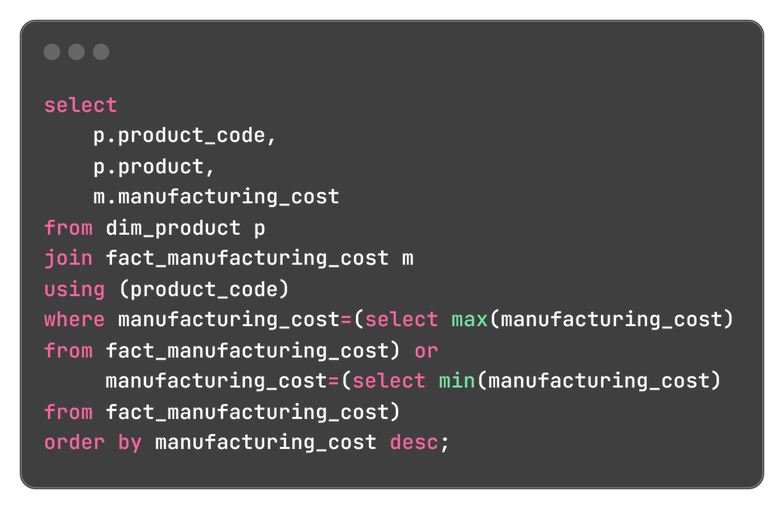

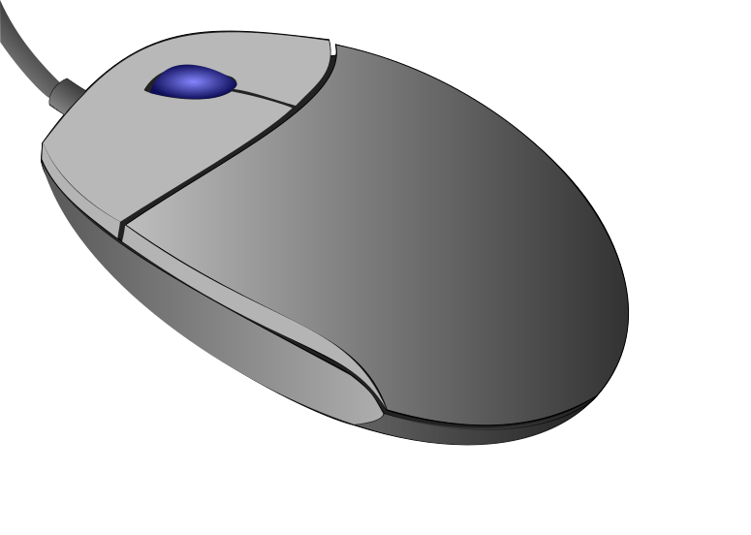
Query
Insight
AQ HOME Allin1 Gen 2
Personal Desktop
AQ Master wired x1 Ms
Mouse

Slide 19
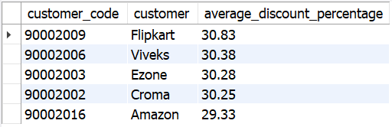
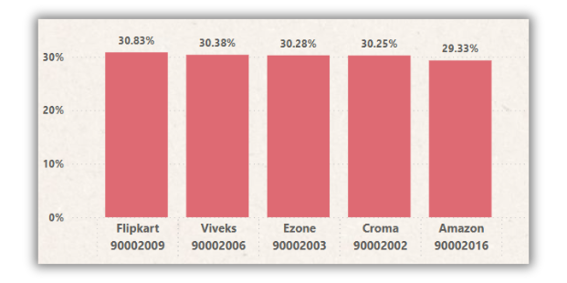
Request #6
Generate a report which contains the top 5 customers who received an average high pre_invoice_discount_pct for the fiscal year 2021 and in the Indian market.
Output/Visual

Slide 20
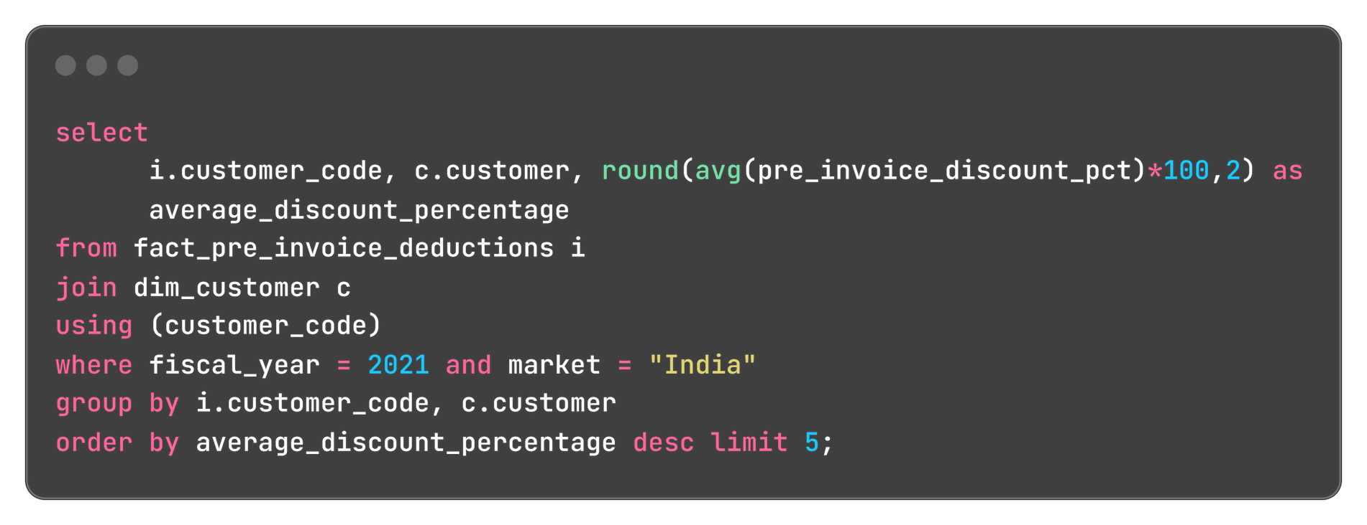
Query
Insight
In 2021, our top 5 customers received nearly equal pre-invoice discounts, with Flipkart receiving the highest at 30.83%

Slide 21
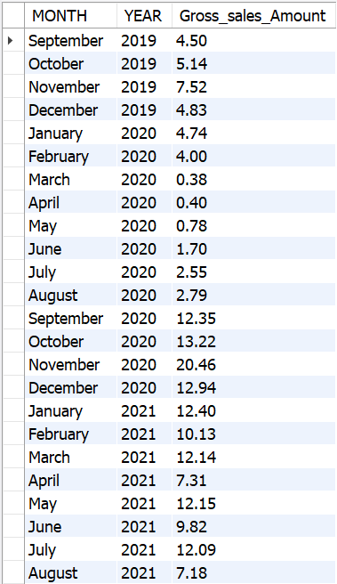
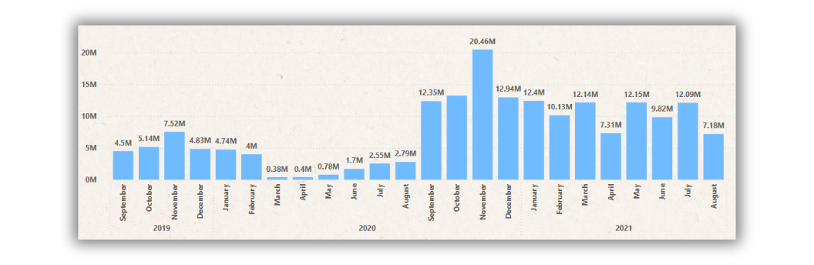
Request #7
Get the complete report of the Gross sales amount for the customer “Atliq Exclusive” for each month.
Output/Visual

Slide 22
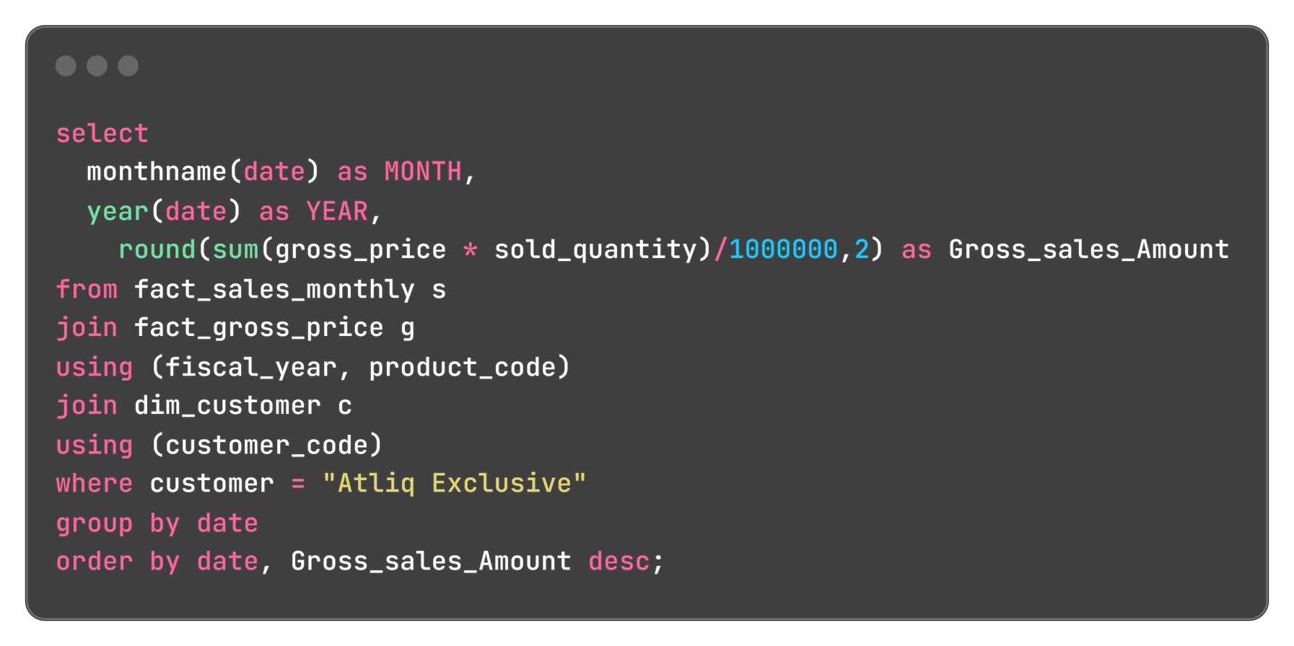
Query
Insight
For Atliq Exclusive, the highest sales occurred in November 2020 at $20.46 million, while the lowest were in March 2020 at $0.38 million, primarily due to COVID-19. Sales rebounded from September 2020 onward, highlighting recovery post-pandemic and a boost from the festival season.

Slide 23
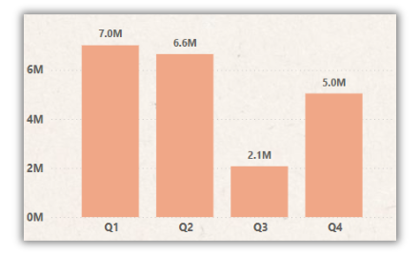
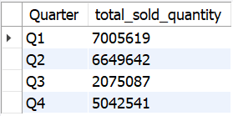
Request #8
In which quarter of 2020, got the maximum total_sold_quantity?
Output/Visual

Slide 24
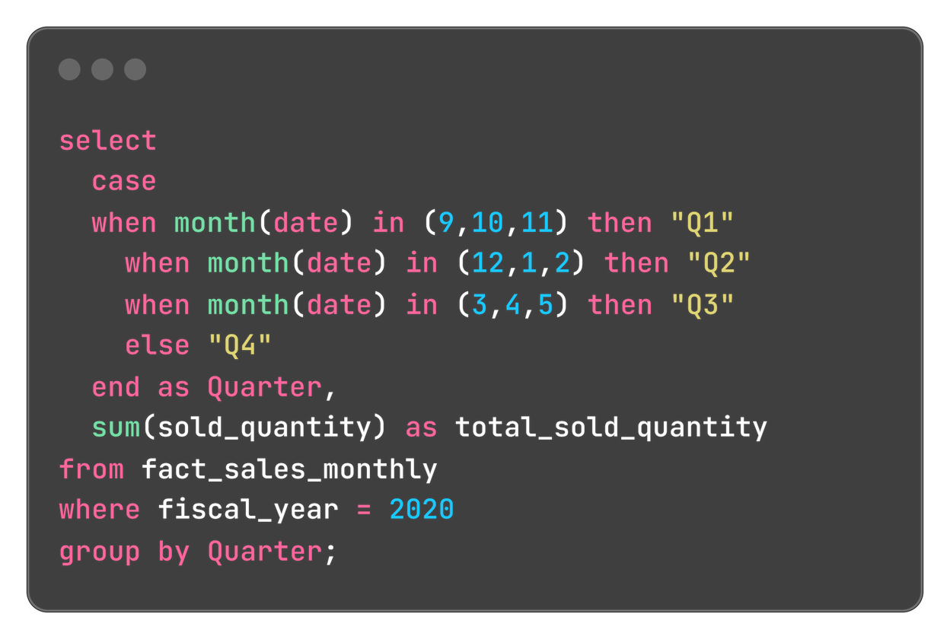
Query
Insight
In FY2020, Quarter 1 saw the highest sales, while Quarter 3, impacted by the COVID-19 pandemic, recorded the lowest. The sales rebounded in Quarter 4, driven by increased demand for computer accessories as remote learning surged

Slide 25
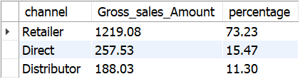
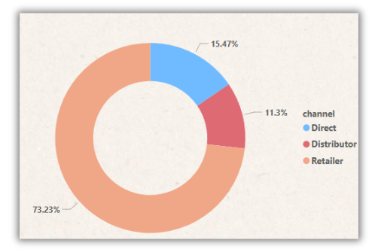
Request #9
Which channel helped to bring more gross sales in the fiscal year 2021 and the percentage of contribution?
Output/Visual

Slide 26
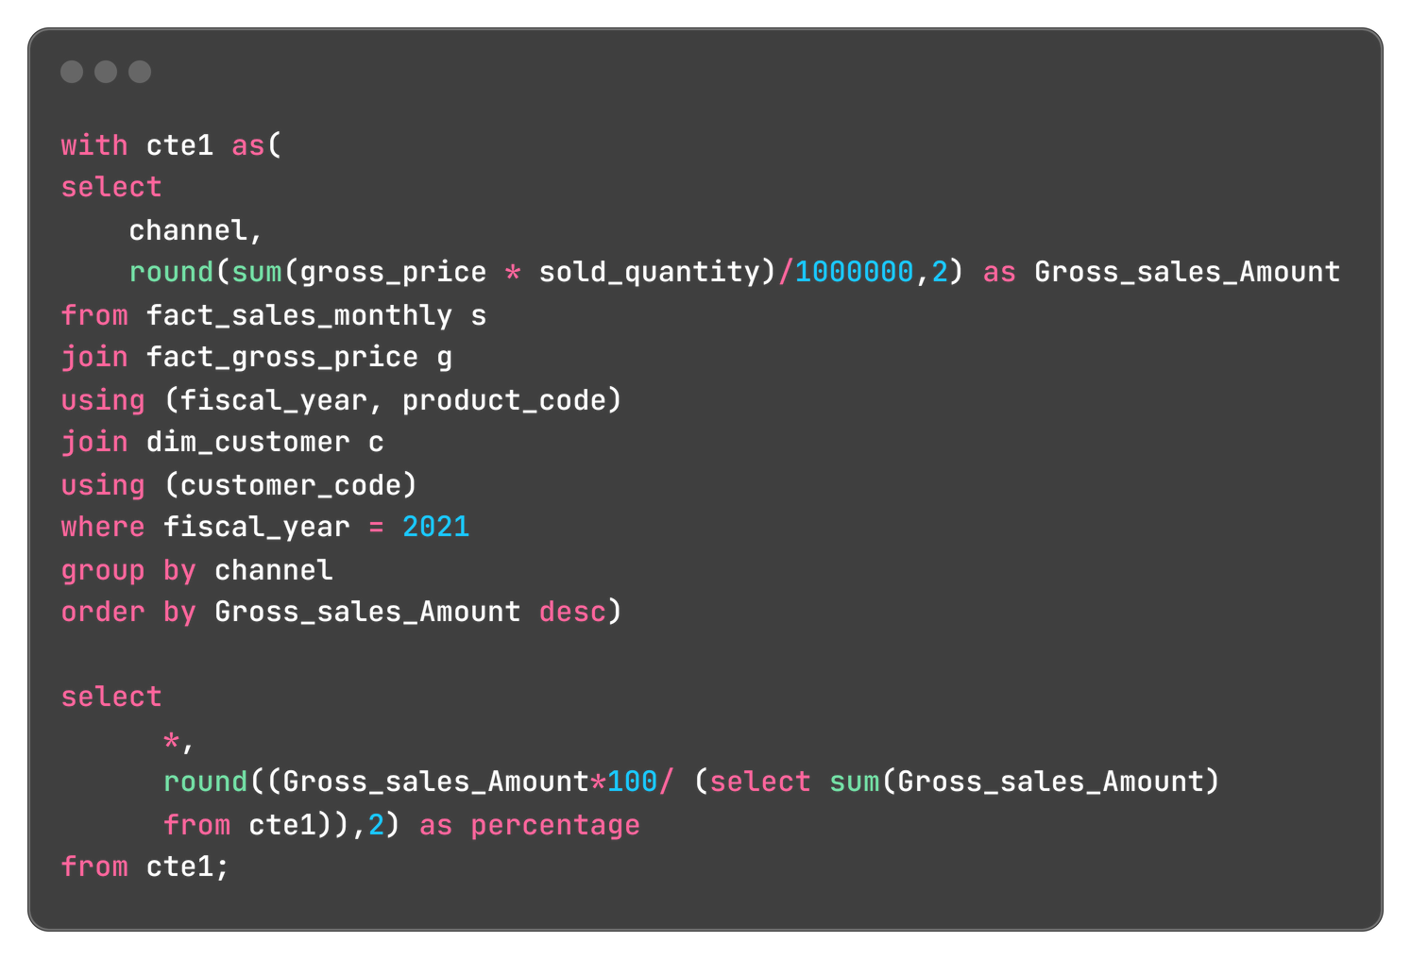
Query
Insight
In FY 2021, retailers drove the majority of sales, contributing 73.23% of gross sales, while distributors lagged behind with only 11.31%. Retail channels proved dominant, generating $1219.08 million compared to $257.53 million from direct sales and $188.03 million from distributors.

Slide 27
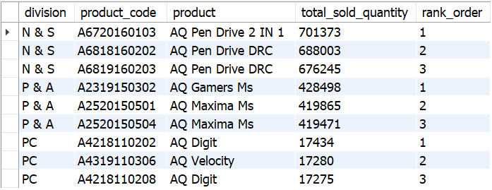
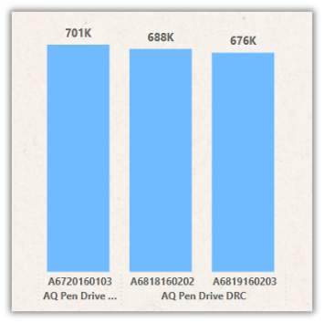
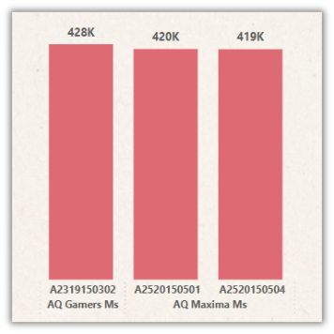
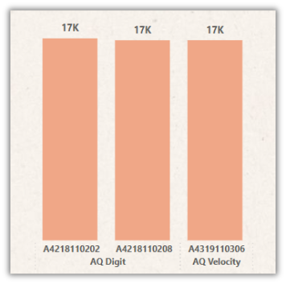
Request #10
Get the Top 3 products in each division that have a high total_sold_quantity in the fiscal_year 2021?
Output/Visual
1
2
3
1
2
3
1
2
3
N & S
P & A
PC

Slide 28
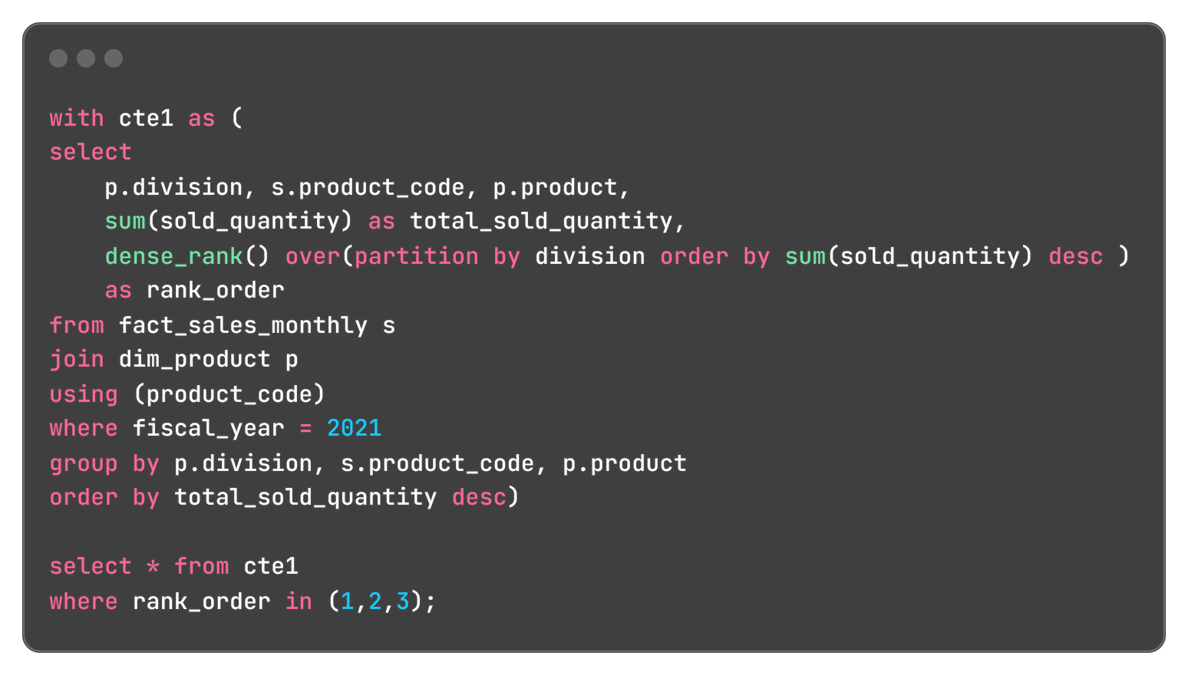
Query
Insight
In FY 2021, the AQ Pen Drive series led sales in the N&S division, while AQ Gamers Ms dominated P&A, and AQ Digit PC was the top performer for PC. The disparity in PC sales suggests an opportunity for strategic initiatives to boost performance in this division.

Slide 29
Thank you

